Slide 1
User Centered Design
Amir Dirin
https://padlet.com/amir_dirin1/x40de2ccmiyacoae
https://edu.flinga.fi/s/EJ97NAP

Slide 2
wk1
UX, Usability, UCD
wk2
UX, Usability, UCD
wk3
Concept Design
wk4
Concpet Evaluation
wk5
Prototype Design / Tools
wk6
Prototype Evaluation
wk7
Usability Evaluation

Slide 3
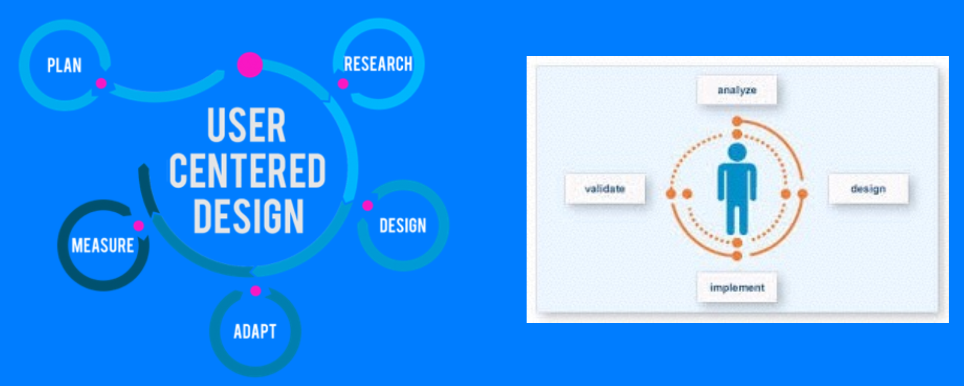
UCD

Slide 4

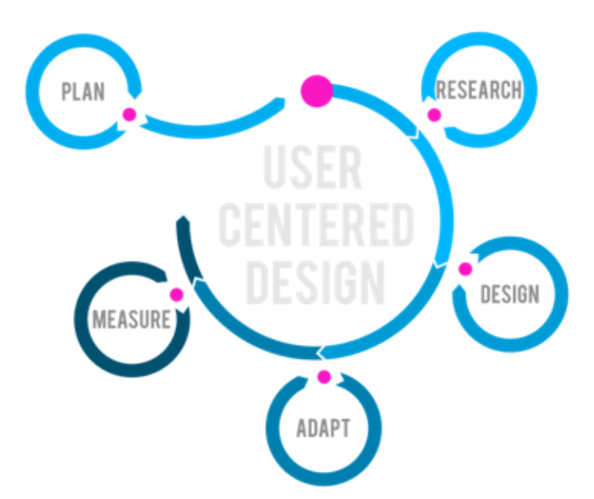
The User

Slide 5
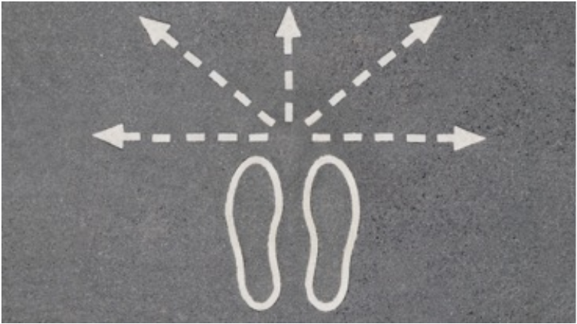
UCD (Users)
Do not put your shoes in users shoes
They may not even wearing shoes

Slide 6

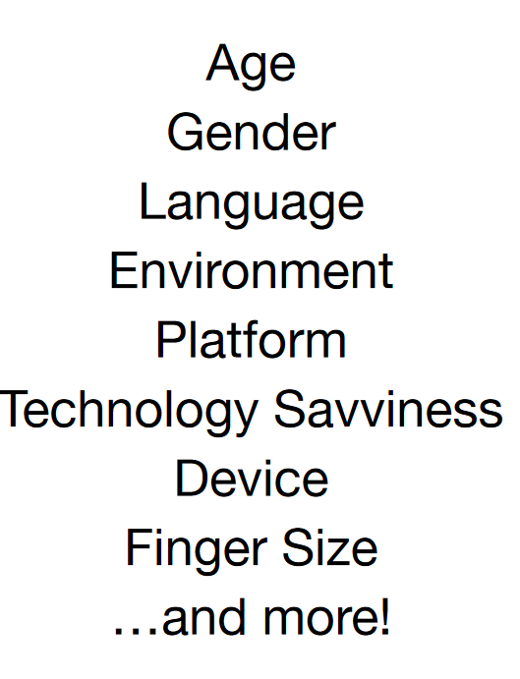
Defining Users

Slide 7
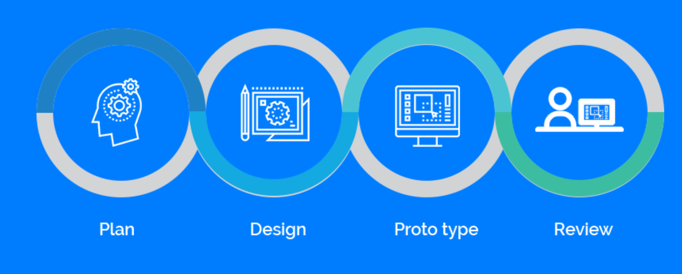
UCD Process
To achieve the best UX

Slide 8

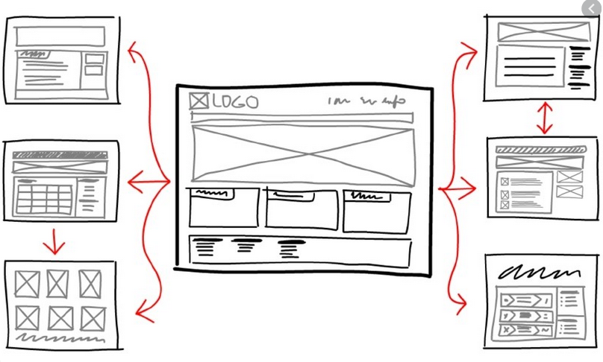

The Process
Requirements
Who, What, Where, When, Why
Define Goals, Requirements, Research & User Stories / Scenarios
2. The Art Design-Visual Magic
User Flow, Wireframes / prototypes Designs
3. Evaluate / Observations
User Testing Iterations

Slide 9
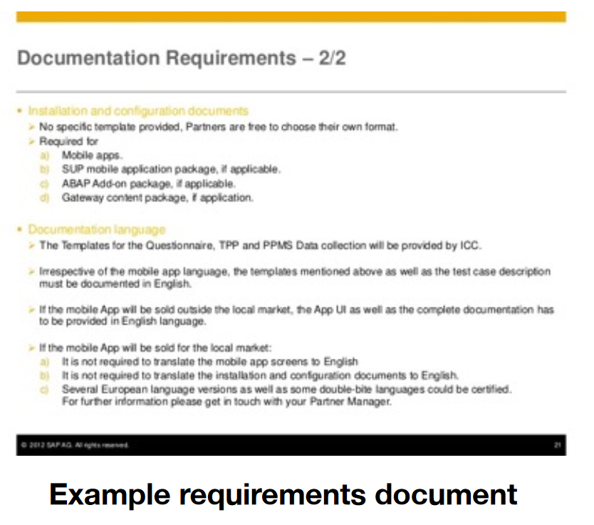
Requirements

Slide 10
User Stories / Scenario
User Story” Defining your user. Follow what a user would go through Know their age, their language, their familiarity with the system you are trying to design

Slide 11
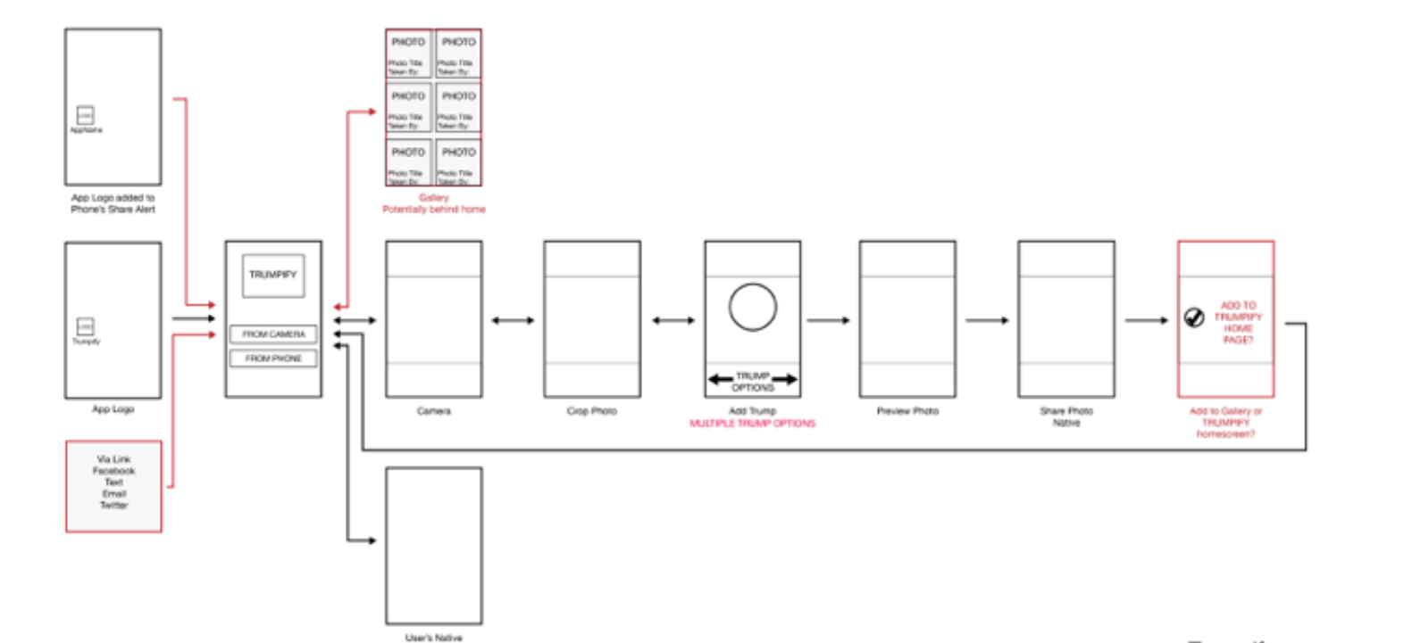
User Flow

Slide 12
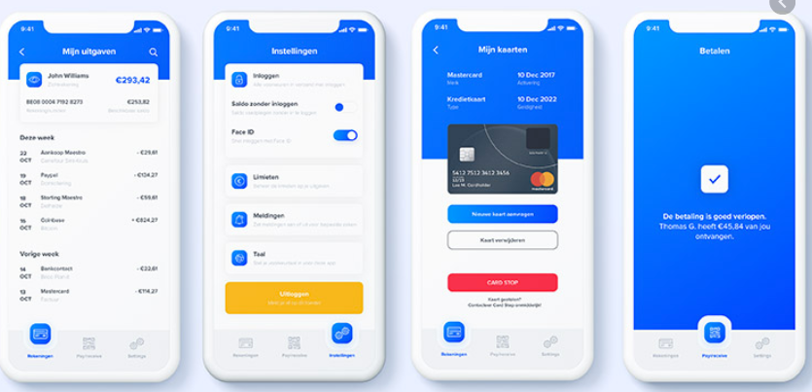
Design

Slide 13

User Testing
Set up a user test
Have them walk through, talking out loud.
Sit next to them or behind them is the simplest way.
Don’t guide them.

Slide 14
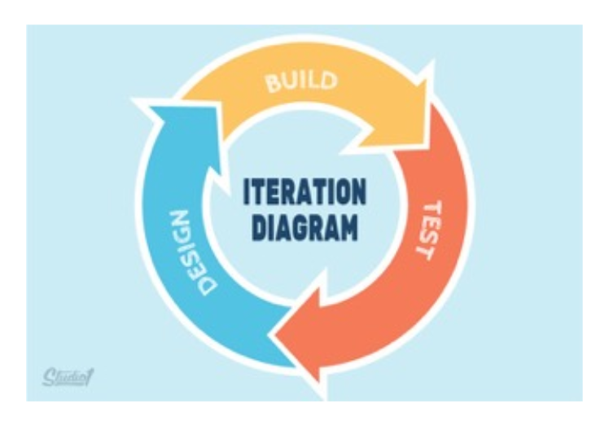
Iterations
Throughout Process- Testing
You will have findings- bring them back to the designs and requirements

Slide 15
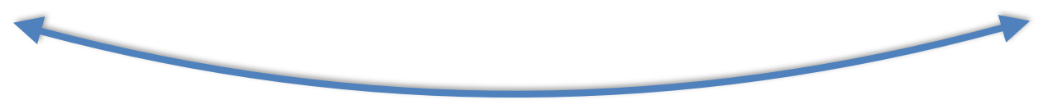
The Process
The process isn’t always completely forwards

Slide 16
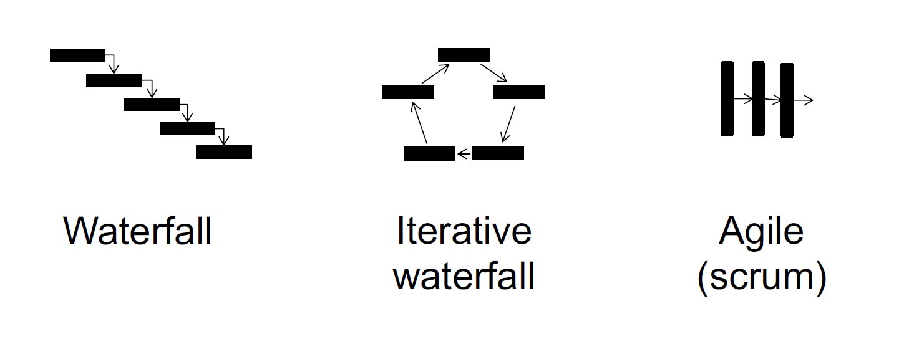
Software engineering processes
How UCD fits in these process?

Slide 17
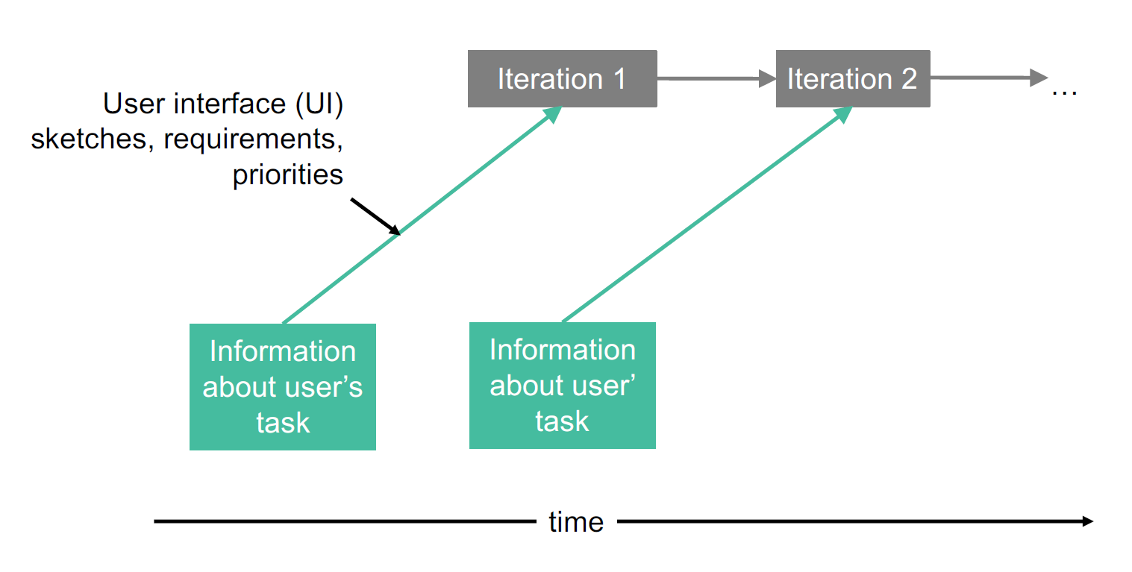
Design one sprint ahead

Slide 18
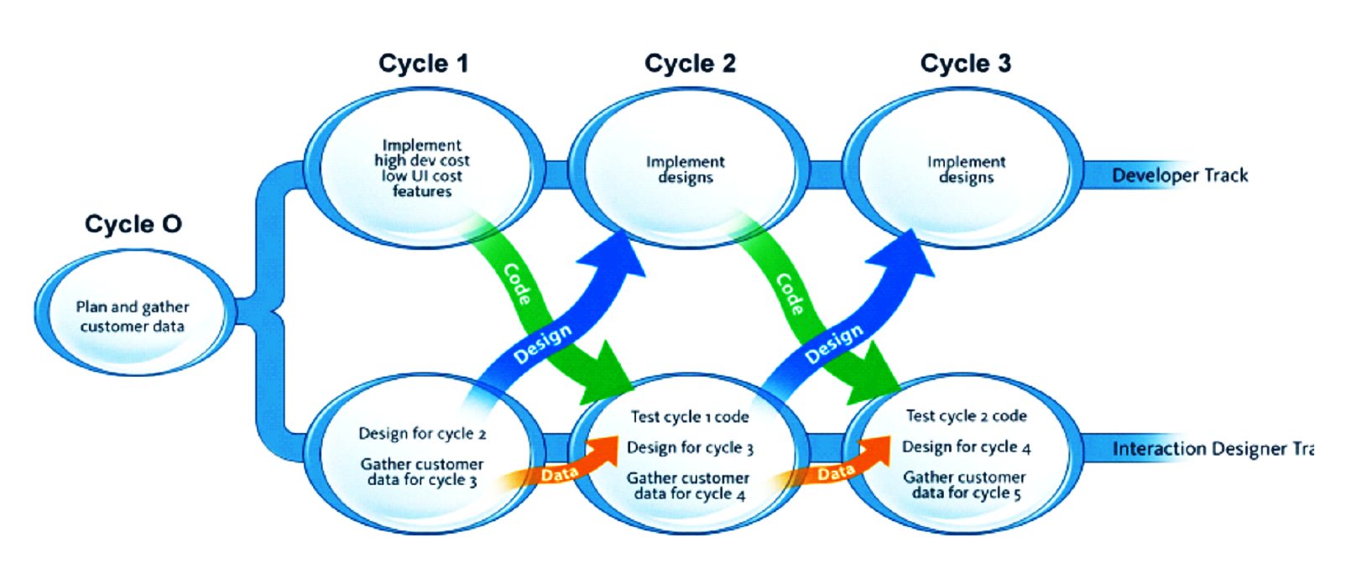
Adapted from Sy (2007) Adapting usability investigations for agile user-centered design.
Journal of Usability Studies. Vol. 2, Issue 3, pp. 112–132.

Slide 19
Why should UCD be one step ahead
UCD development is cheap

Slide 20
Individual Assignment (Today)
Design is all about making trade-offs and working within a set of constraints. Bad designs usually are not bad on purpose. No one sets out to design something poorly. Think about a product that you have used that has some design flaws or has had a bad user experience. Why do you think the designers ended up with that design? What constraints might they have been working up against and what trade-offs do you think they made? If you had to make that product better, what approach might you take?

